Slide 1

The Strategic Plan
A review
of the eight strategies common
to all organizations

Slide 2
Strategic Planning Schedule
9 – 10 Tarion Situation Analysis Review
10:10 - 11 Identifying External Factors
11:10 - 12 Connecting External Factors to Strategy
12 - 1:00 Lunch
1 - 1:50 Developing Strategic Issues
2 - 2:50 Communicating the Strategic Plan
3 - 3:45 Testing Strategy
3:45 - 4 The Strategic Plan

Slide 3
Module 1
Tarion Situation Analysis Review

Slide 4
Strategic Plan Content
Facts
The Situation
Analysis
The Fact Gathering Process
Major External Factors
Stakeholder Expectations
Organizational Performance
Description of Current Strategies and Strategy Configuration
2. Analysis
Issue
Development
The Analysis Process
Likely Impact of Major Factors
A Ranking of Major Factors & Expectations
Possible Responses & Rationale
3. Strategy
The Change
Agenda
A Description of Changes, if any, to Strategy
An Explanation of the Rationale for Change
Impact on the Organization (Timing and Degree)
Major Risk Factors / Assumptions
Financial Implications
Long Term Hoped for Impact

Slide 5
Separating Fact vs. Fiction
Fiction Tarion’s Board of Directors is controlled by the builders
Fact Builders only ever had 8 of 16 seats on the board. Now will have 4 of 12.
Fiction Tarion’s responsibilities as a regulator and warranty vendor conflict
Fact The KPMG study found the close relationship a significant success factor.
Fiction All builders pay the same registration fee
Fact The basic registration fee may be the same but conditions of licensing vary dramatically.
Fiction Tarion has a monopoly on new home warranty insurance
Fact All new homes must carry the Tarion warranty as the minimum warranty – not the only warranty
Fiction New home building industry standards in Ontario need to be improved
Fact New home industry standards are the highest of any jurisdiction in Canada.
Fiction BC has put into place a new home warranty program structure that Ontario should adopt
Fact The BC program is unproven and the BC market for is a fraction of the size of the Ontario market.
Fiction Tarion should extend its warranty coverage to the renovation industry
Fact The renovation industry is fundamentally different from the new home building industry

Slide 6



Understanding the ONHWP Act Model
Consumer Protection
Risks to Consumer
Builder Risk
Assuring Builder Ability to Perform
Insuring Builder Failure to Perform
Regulatory Protection
Mandatory Builder
Registration & Minimum Standards of
Acceptable Builder Performance
Financial Compensation
No-fault Consumer Warranty Coverage
& Simplified Consumer
Claims Process
Delivered by a not-for-profit industry stakeholder controlled
Corporation & completely self-funded from fee income
Accountable to
Ministry (MOU)
Accountable to
Industry
Stakeholders
Accountable to
Corporate Law

Slide 7









Current Strategy Configuration
Notes:
Strategic Management © 2017 Alan W. Kennedy
2 - 7

Slide 8
The Alphas | Current Strategy
Mandate | Administration of the ONHWP Act.
Risk | First, make the builder perform. Secondly, use of security / reserves
Growth | Rise and fall with the new home building industry cycles
Financial | Self-funding / Use of insurance industry reserving practices
Technology | Enable management productivity
Organization | Centralized / Expectations are to take a policing approach
Communications | To educate new home buyers and home builders on their responsibilities
Service Delivery | To deflect risk away from Tarion onto builders
Notes:
Strategic Management © 2017 Alan W. Kennedy
2 - 8

Slide 9
The Alphas | Current Strategy Issues
Mandate | Should the scope of Tarion’s mandate be increased to include renos and conversions?
Risk | Should Tarion impose security requirements on all builders?
Growth | Should Tarion be allowed to move into other building industry segments?
Financial | Should Tarion reduce operating costs?
Technology | Should Tarion introduce greater use of technology?
Organization | Should Tarion change its culture from that of enforcement to that of an insurer?
Communications | Should Tarion publish detailed information on builder performance?
Service Delivery | Should Tarion replace its conciliators with insurance adjustors?
Notes:
Strategic Management © 2017 Alan W. Kennedy
2 - 9

Slide 10
Warranty Industry Analysis
Segment What is my chosen market called? | New Home Warranty
Segment Size / Growth How big is it and is it growing? | Averages 50,000 new homes but drops dramatically in times of recession Growth is a function of condo popularity in the major cities, provincial economy and population growth
Segment Dynamics What dynamics are most shaping the segment? Customers/competitors/ Suppliers/Barriers to Entry/Alternatives | Consumers don’t want to pay cost until they need protection Mortgage lenders require warranty on mortgages Competitive pressure: lower costs, more choice
Critical Success Factors What must a competitor do to succeed? | not-for-profit status of Tarion (to recognize economic fragility) industry self-management model (to recognize need to balance true cost/liability associated with added consumer protection elements bundled regulatory authority / insurance responsibility (to recognize need to enforce a minimum standard) no-fault coverage for consumers (i.e. whether home or builder are registered) autonomy from government to isolate capital reserves and fees from political pressure ongoing management of stakeholder expectations to stay aligned with major stakeholder groups
Segment Evolution How is this segment likely to change over time? | The model could evolve as the regulator of more segments of the housing industry

Slide 11
Warranty Competitor Analysis
Warranty Industry Attractiveness | Competitors | Travelers The Guarantee National Home Warranty & Aviva Canada Pacific Protected
 | Competitor Focus | Excess deposit insurance for condo buyers (i.e. over $20,000 Conversion project warranty insurance
Warranty Industry Critical Success Factors | Competitor Strengths | Cost Control / Productivity Online accessibility – Clear processes Marketing - Pricing Product selection Financial strength Developing a strong builder customer base
 | Competitor Weaknesses | No commitment to stay in the market No commitment to small builders Warranty is a trigger product
Warranty Industry Evolution | Likely Future Competitors | Private sector competitors from other provinces/US
 | Likely Areas of Functional Excellence | On-line delivery of builder and consumer services

Slide 12
Regulator
Stakeholder Focus Analysis
Question | Answer
1. Does our mandate suggest who should be our primary focus for its effective delivery? | Builders are the primary focus of the regulator. The mandate requires the regulator to enforce the Act’s provisions which amongst other things, requires, mandatory builder registration, new home registration, and enforcement of Act compliance, being primarily illegal (i.e. unregistered new home building for sale).
2. What attracts is the cause of their unwillingness to comply? | Unwillingness of some builders to comply is caused by their belief that they won’t get caught because they are building in small numbers, have co-opted the purchaser,
3. How do we compare to alternatives for addressing risk assumed in our mandate? | The KPMG global study suggests the paired role of regulator/warranty insurer is a key success factor, industry best practice, and probably explains Tarion’s success. That said, there are many who would prefer to see the regulator returned to gov’t.
4. Which of our programs / services are truly successful in addressing the reducing risk? | Working in cooperation with municipal building permit departments has enabled effective identification of non-complying builders and increased conviction rates
5. Do we understand the factors driving the creation of the risk | Repeat offenders are likely to continue to offend Failure to review building permits against home registrations Offender belief that it is hard to get caught
6. How is the risk behavior of our primary focus group likely to change? | As enforcement improves with more cooperation with municipalities and the use of analytical software to profile likely offenders, very likely these illegal builders will look for opportunities outside the scope of the Act such as renovations, retrofits, and conversions
7. What services are going to be needed to address new emerging risks? | The renovations, retrofits, and conversions market for homes will need regulating

Slide 13
Module 2
Identifying External Factors

Slide 14
External Factors Identified
External Factor | Description
1. Technology | All manner of technology to enable productivity & e-business
2. Case Law / Judicial Decisions | Case law and judicial decisions impacting Tarion
3. Warranty Competitors | Private sector warranty vendors
4. Best Practices | Best practices in business & government
5. Builder Expectations | Reduce Tarion operating costs; reduce cost of warranty or increase its limits
6. Ministry Expectations | Stop new homebuyer complaints and media attention on Tarion
7. The Act and Regulations | The current model of consumer protection as described in the Act & Regs
8. Consumer Expectations | Faster and much more simplified claims process; less secrecy
9. Transparency | The trend to fuller information disclosure in government (i.e. less secrecy)
10. E-Commerce | Much more online accessibility by consumers, new homebuyers and builders
11. The Media | Print / T.V./ Radio and social media reporting on Tarion
12. BC New Home Warranty Program | The regulatory and warranty scheme now in place in BC
13. Insurance Industry Risk Practices | Pricing and use of security in the management of insured risk
14. Financial Regulatory Requirements | Capital and reporting requirements imposed on Ontario insurers
15. Construction Practices | Materials, practices, & products being used by Ontario builders

Slide 15
Nominal Group Factors Ranking
Your Ranking of Factor | Factor Name or # as shown on list of External Factors Identified
Your #1
Your #2
Your #3
4
5
6
7
8
9
10

Slide 16
Factors Scoring
The Factors | X10 | X9 | X8 | Total | Rank

Slide 17
Module 3
Connecting External Factors
to Strategy

Slide 18
Strategic Issue Definition
A Strategic Issue is a question about strategy:
Do we improve existing strategy or get a new strategy?

Slide 19
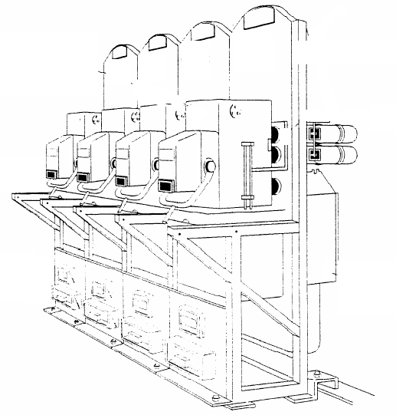
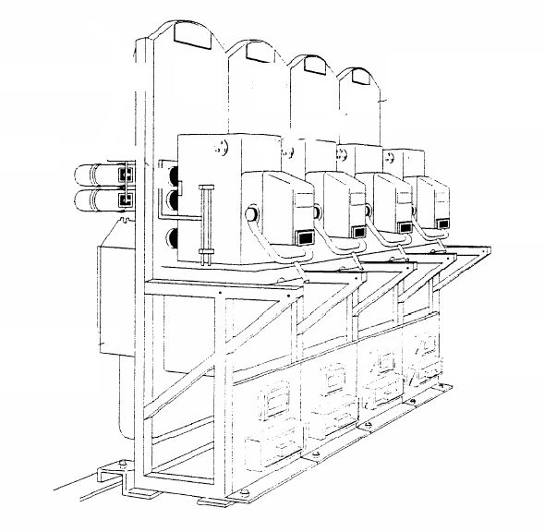
The CEO Aligns the 8 Strategies with Major Stakeholder Expectations and Competitive Reality
Mandate
Bus Definition
Marketing /
Communi-
cations
Production/
Service
Delivery
Risk
Growth
Org
Finance
Tech
Changing
Trends
Change in Alternatives/
Competition
Changes in
Demand
Changed
Stakeholder
Expectations
Industry
Change
Changes in
Need / Risk
Changes in
Best Practices

Slide 20
All Managers Align Activities
Assigned to Them to Strategic Plan Expectations first and with competitive reality second
Call
Centre
Training
Recruiting
Marketing /
Services
Customer
Relations
Monitoring
Admin
Compliance
Budget
Changed
Expectations

Slide 21
Alpha Sets Culture
Organization
8 Strategy Focus
Actual Strategy
Identity
IBM
Business Definition
Morphing to the high margin
Information Technology
Stantec
Growth
Growth by Acquisition
Major Global Design Firm
Bank of Canada
Risk
Managing Investor Expectations
Canada’s Financial
Risk Manager
Bank of Montreal
Financial Management
Deposit-Taking
The Bank of No Surprises
Frank Gehry Architects
Organization
Starchitect
One-of-a-kind design
Google
R&D / Technology
To manage all your
information needs
The Biggest Cloud
Nike
Marketing
Clothing for winners
The Swoosh
FedEx
Service Delivery
24 Hour Delivery
Service Excellence
Notes:
Strategic Management © 2017 Alan W. Kennedy
2 - 21

Slide 22
Strategy Focus (Public / NFP)
Entity
The 8 Strategies
Mandate can never be dominant strategy for
A NFP / Public Sector Entity
Mandate
Toronto Police Services
Risk
Ontario Financing Authority
Financial Management
Stratford Theatre Company
Organization Management
National Research Council
R&D / Technology
Canadian Institute of Chartered Accountants
Marketing / Communications
City of Toronto
Service Delivery

Slide 23
3 Tips for Drafting Issues
Tip #1 | “????” / Frame issues as questions
AVOID STATEMENTS There is no need for a warranty conciliation process We need to eliminate the warranty conciliation process |  | ASK QUESTIONS Should we eliminate the warranty conciliation process?
Tip #2 | “Should” / Frame the issue in a way that invites debate
Are we going to… How do we… Can we… Could we… |  | Should we eliminate the warranty conciliation process?
Tip #3 | “Yes” or “No” / Answer the question
 Yes  No  Don’t Know

Slide 24
Issues:
Connecting Factors to Strategy
1 | Description of the External Factor under Discussion:
2 | External Factor Background:
 | a) Without any response from us, what is the likely impact of this External Factor?
 | b) Does current research and analysis offer insight on how best to respond?
 | c) Have we taken action consistent with research to address this External Factor?
 | d) How effective has our action been?
3 | Draft a question that best connects this factor to one of the 8 Strategies
 | Draft Issue: Should
 | ?
4 | Draft Issue Answer  Yes  No  Don’t Know
5 | Further Research Required if answer to #4 is “Don’t Know”:

Slide 25
7 Ways to Avoid Action
1. For every proposal, point out every possible problem.
2. Ask detailed questions which cannot possibly be answered.
3. Profess not to have any answers while earnestly cautioning against proceeding.
4. Emphasize that the issue cannot be separated from all the other issues and therefore, cannot be resolved until all the other issues are resolved.
5. Appoint a consultant.
6. Create a committee.
7. Congratulate the issue. Discussion on it wasted 3 hours, but we are better for it.

Slide 26
Module 4
Developing Strategic Issues

Slide 27
The 2 Basic Strategy Frameworks for All Planning
Assessing Expectations
Assessing Strategy
Expectation 1
Met
Strategy Changed
Expectation 2
not Met
Expectation 2
Met
External Factor
Not Addressed
External Factor
Addressed
Expectation 1
not Met
Strategy Not Changed

Slide 28
Strategy Scenario Development
1. In the lower left, describe how we look today because of the strategy we are using
2. In the upper right, identify an organization that is the best example of what we could look like if we successfully implemented the strategy and it became our Dominant Strategy.
Current Strategy Changed
Who would we want to look like if this became our dominant strategy?
External Factor not Addressed
External Factor Addressed
Who do we look like to an outsider because of our strategy?
Current Strategy not Changed

Slide 29
Strategy Scenario Development
Change Tarion Strategy
External Factor not Addressed
External Factor Addressed
No Change in Tarion Strategy

Slide 30
Strategic Issue Development
First Statement of the Issue:
Should we change our Strategy?
Redrafted Strategic Issue:
Should we change our present strategy
which has characterized us as
to a strategy which will change our image to
and, by
, deliver ?

Slide 31
Module 5
Communicating Strategy

Slide 32
SMART Strategy (Objective) Statement
Precise & specific in content? | 
Performance can be measured? | 
Provides the starting point for action? | 
Realistic balance of expectation & ability? | 
Has a specific deadline? | 
English Bay
Business Definition Strategy / Objective
To return to being a niche retailer over the next 2 years so that 80% of profitability comes from stores serving markets of our target customer

Slide 33
Strategic Assumption Identification
Assumptions
Considered conjecture on specific factors
1. What is the Major External Factor driving Strategy Change?
2. What about that Factor could change and threaten our strategy
3. Do we have a contingency plan if this starts happening?
4. Is this assumption about the Factor beyond our control?
5. Should the assumption about this Factor be monitored.

Slide 34
Strategic Focus
Strategy Framework Element | Present Strategy | Proposed Strategy
Mandate | Administration of the Act
Risk | Compliance enforcement / security & reserves
Growth | Rise and fall with industry cycles
Financial Management | Insurance risk best practices
R&D/Technology | Enable management
Organizational Design | Centralized as a regulator
Communications | Educate stakeholders
Service Delivery | Deflect risk to builders

Slide 35
Impact of Strategic Focus (Change Implementation)
Strategy Framework Element | How will change be implemented? | Present Strategy
Mandate |  | Administration of the Act
Risk |  | Enforce compliance and embrace insurance practices
Growth |  | Rise and fall with industry cycles
Financial Management |  | Insurance risk best practices
R&D/Technology |  | Enable management
Organizational Design |  | Centralized as a regulator
Communications |  | Educate stakeholders
Service Delivery |  | Deflect risk to builders

Slide 36
Module 6
Testing Strategy

Slide 37
Current Strategy Configuration
Notes:
Strategic Management © 2017 Alan W. Kennedy
2 - 37

Slide 38

Notes:
Strategic Management © 2017 Alan W. Kennedy
2 - 38

Slide 39

The Alpha Strategies | Strategy
Mandate | As stated under the York University Act. 1965
Risk | Enterprise risk management
Growth | “If we build it, they will come”
Financial | Debt / government funding / donations / tuition fees
R&D / Technology | Enabler
Organization Mgmt | Bicameral system (Separate Academic and Administrative Governance)
Marketing / Sales | Focused on attracting students and donors
Service Delivery | Graduate and undergraduate degree programs across 11 faculties.
39

Slide 40


40

Slide 41

8 Strategy | Strategy
Business Positioning | Hydro Ottawa Limited is an Ontario regulated electricity local distribution company (LDC) that owns and operates distribution infrastructure in the City of Ottawa and the Village of Casselman and is the largest LDC in eastern Ontario and the third largest municipally-owned LDC in the Province of Ontario.
Risk | Hydro Ottawa manages risk by staying in compliance with the regulatory framework impacting the industry to employ fixed price contracts to reduce exposure to spot market prices, the continuance of Hydro Ottawa’s exceptional health and safety record,
Growth | Hydro Ottawa growth is strategy s expanding our distribution business beyond our current service territory;
Financial | Hydro Ottawa is a MEU under the Electricity Act. Revenues are regulated. Finances are managed to retain its credit-rating; compliance with OEB requirements, and, if appropriate, dividends to the parent
Technology / R&D | Hydro Ottawa has 2700 kilometres of underground cable, 2,700 kilometres of overhead lines, 40,500 transformers and 48,700 hydro poles.,Ottawa Hydro will introduce more intelligence and automation into our distribution system, in 2014, Hydro Ottawa will complete the development of a more detailed Smart Grid plan, as required by the Green Energy and Green Economy Act.
Organization | Hydro has a workforce of about 600 employees of which a large percentage are eligible for retirement in the next 5 years creating the need for a workforce replacement strategy and the development of a skilled, engaged and prepared workforce for the future
Marketing | Hydro Ottawa serves the residential; small business and bulk-metered; and large user customer segments The fundamentals of customer value in the electricity business are quality and cost – delivering a reliable service, while operating efficiently and effectively to keep rates competitive. Hydro Ottawa is consistently among the top performers in Ontario in both of these areas.
Service Delivery | Hydro Ottawa Limited has two core responsibilities. First, Hydro Ottawa is responsible for the safe and reliable delivery of electricity to more than 300,000 customers in the City of Ottawa and the village of Casselman. Second, Hydro Ottawa Limited bills for its services and for the services provided by other organizations in Ontario's electricity system.
41
Notes:
Strategic Management © 2017 Alan W. Kennedy
2 - 41

Slide 43

The 8 Strategies | Stantec Strategy
Business Definition | Fully integrated North American engineering and architectural services
Risk | Market, services, and life cycle diversification and no exposure to construction risk
Growth | To become and remain a top 10 global design firm through acquisitions
Financial Management | NYSE /TSX listed and growth funded by issuing equity
Technology | To support Best Trained, Best Informed, Best Equipped employees
Organization | Use of a Balanced Leadership Model for top and bottom line focus
Marketing | A top 3 service provider in chosen markets and seen as a Single Brand Identity
Service Delivery | Local Strength – Global Expertise; One Team. Infinite Solutions
43

Slide 44


Slide 45

The Alphas | Strategy
Business Definition | To be the global leader in “enterprise” wireless data communications
Risk | To protect our intellectual property and to protect network security and integrity
Growth | To resize to fit our chosen markets
Financial Management | To access capital markets through TSX / NASDAQ listings
R&D / Technology | To focus development of our proprietary platforms & services
Organization Mgmt | To use the strength of market position and value proposition to enable HR “pull” potential employees and to leverage proximity and relationship with University of Waterloo
Marketing | QNX software BB Messenger chat app Fleet mgmt for gov’t & corp users
Service Delivery | To deliver data security and network reliability
Notes:
Strategic Management © 2017 Alan W. Kennedy
2 - 45

Slide 47
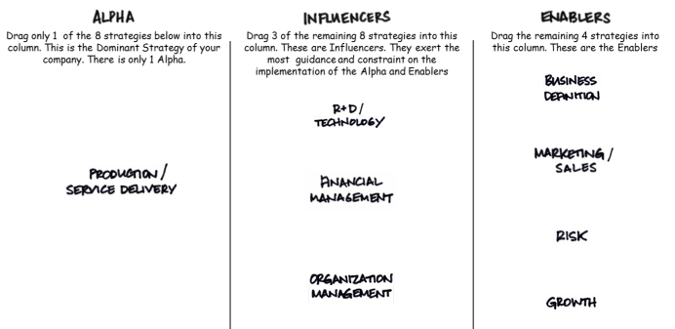
The Growing-Up Years
1953 - 1975

Slide 48
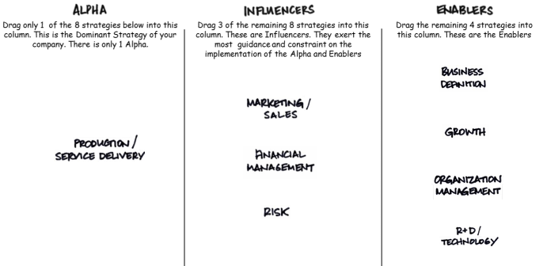
The Maturing Years
1976 - 1993

Slide 49
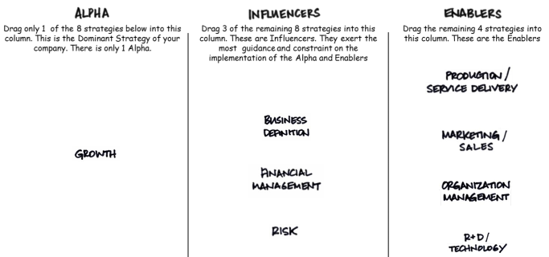
The Acquisition Years
3. Evolution
of a Firm
1994 - 2011

Slide 50
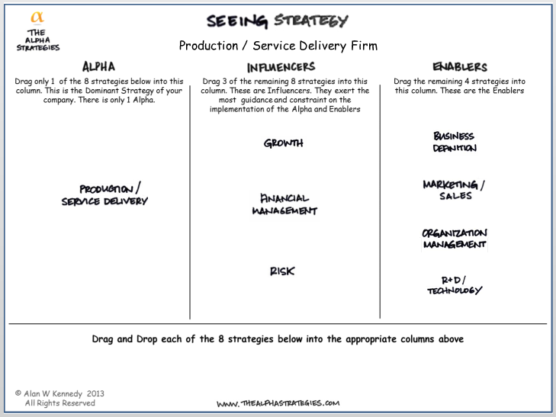
The Future:
A Top Ten Global Design Firm
3. Evolution
of a Firm
2012 - 2025

Slide 51
Schedule “B”
The Strategic Plan

Slide 52
Course Deliverables
Day 1
Produce a Situation Analysis
Day 2
Produce a Strategic Plan
Day 3
Produce a Business Plan

Slide 53
Wrap Up of the 6 Modules
Module 1 Current state understanding is the starting point for planning
Module 2 Only external factors should drive strategy decisions
Module 3 Connecting factors to strategy is step one to strategy insights
Module 4 Matrices of factors and strategies can produce Scenarios
Module 5 Communicating the plan requires selling strategy change (if any)
Module 6 Testing means understanding long term strategy change impact

Slide 54
Day Three Preparation
Review the Manager or Imposter case
Review the Day 3 Materials
Review the Business Plan (Schedule “C”)

