Slide 1


Strategic Management
Leveraging Individual Strategic Thinking
to Produce
Superior Organizational Performance
by
Alan W. Kennedy
August 2020
© 2020 Alan W. Kennedy on behalf of Schulich Executive Education Centre (SEEC). All rights reserved.
No part of this publication may be reproduced, stored in a retrieval system, or transmitted in any form or by any means, electronic, mechanical, recording, photocopying or otherwise, without written permission of the copyright holder.

Slide 2
Table of Contents
Day One: Situation Analysis
Introductions and Defining Strategy p. 3 - 10
The Strategy System p. 11 - 13
Using the Strategy Model p. 14 - 19
Getting Ready for Planning p. 20 - 21
The Internal Assessment p. 22 - 33
The External Assessment p. 34 - 38
The Situational Analysis p. 39 – 54
Wrap-Up p. 55 - 58
Day Two: Strategic Planning
Tarion Situation Analysis Review p. 3 - 12
Identifying External Factors p. 13 - 16
Connecting External Factors to Strategy p. 17 - 25
Developing Strategic Issues p. 26 - 30
Testing Strategy p. 31 - 35
Communicating the Strategic Plan p. 36 - 50
Wrap-Up p. 51 - 54
Day Three: Business Planning
Strategy Choices Review p. 3 - 10
Reviewing the PSSA Strategic Plan p. 11- 17
Identifying Strategic Plan Expectations p. 18 - 24
Identifying Expectations Impact on Strategy Choices p. 25 - 28
Developing the Dept Business Plan p. 29 - 31
Business Plan Presentation p. 32 - 36
Wrap-Up p. 37 - 41
Schedules
The Situation Analysis “A”
The Strategic Plan “B”
The Business Plan “C”
Bibliography “D”

Slide 3
Introductions and Course Overview

Slide 4
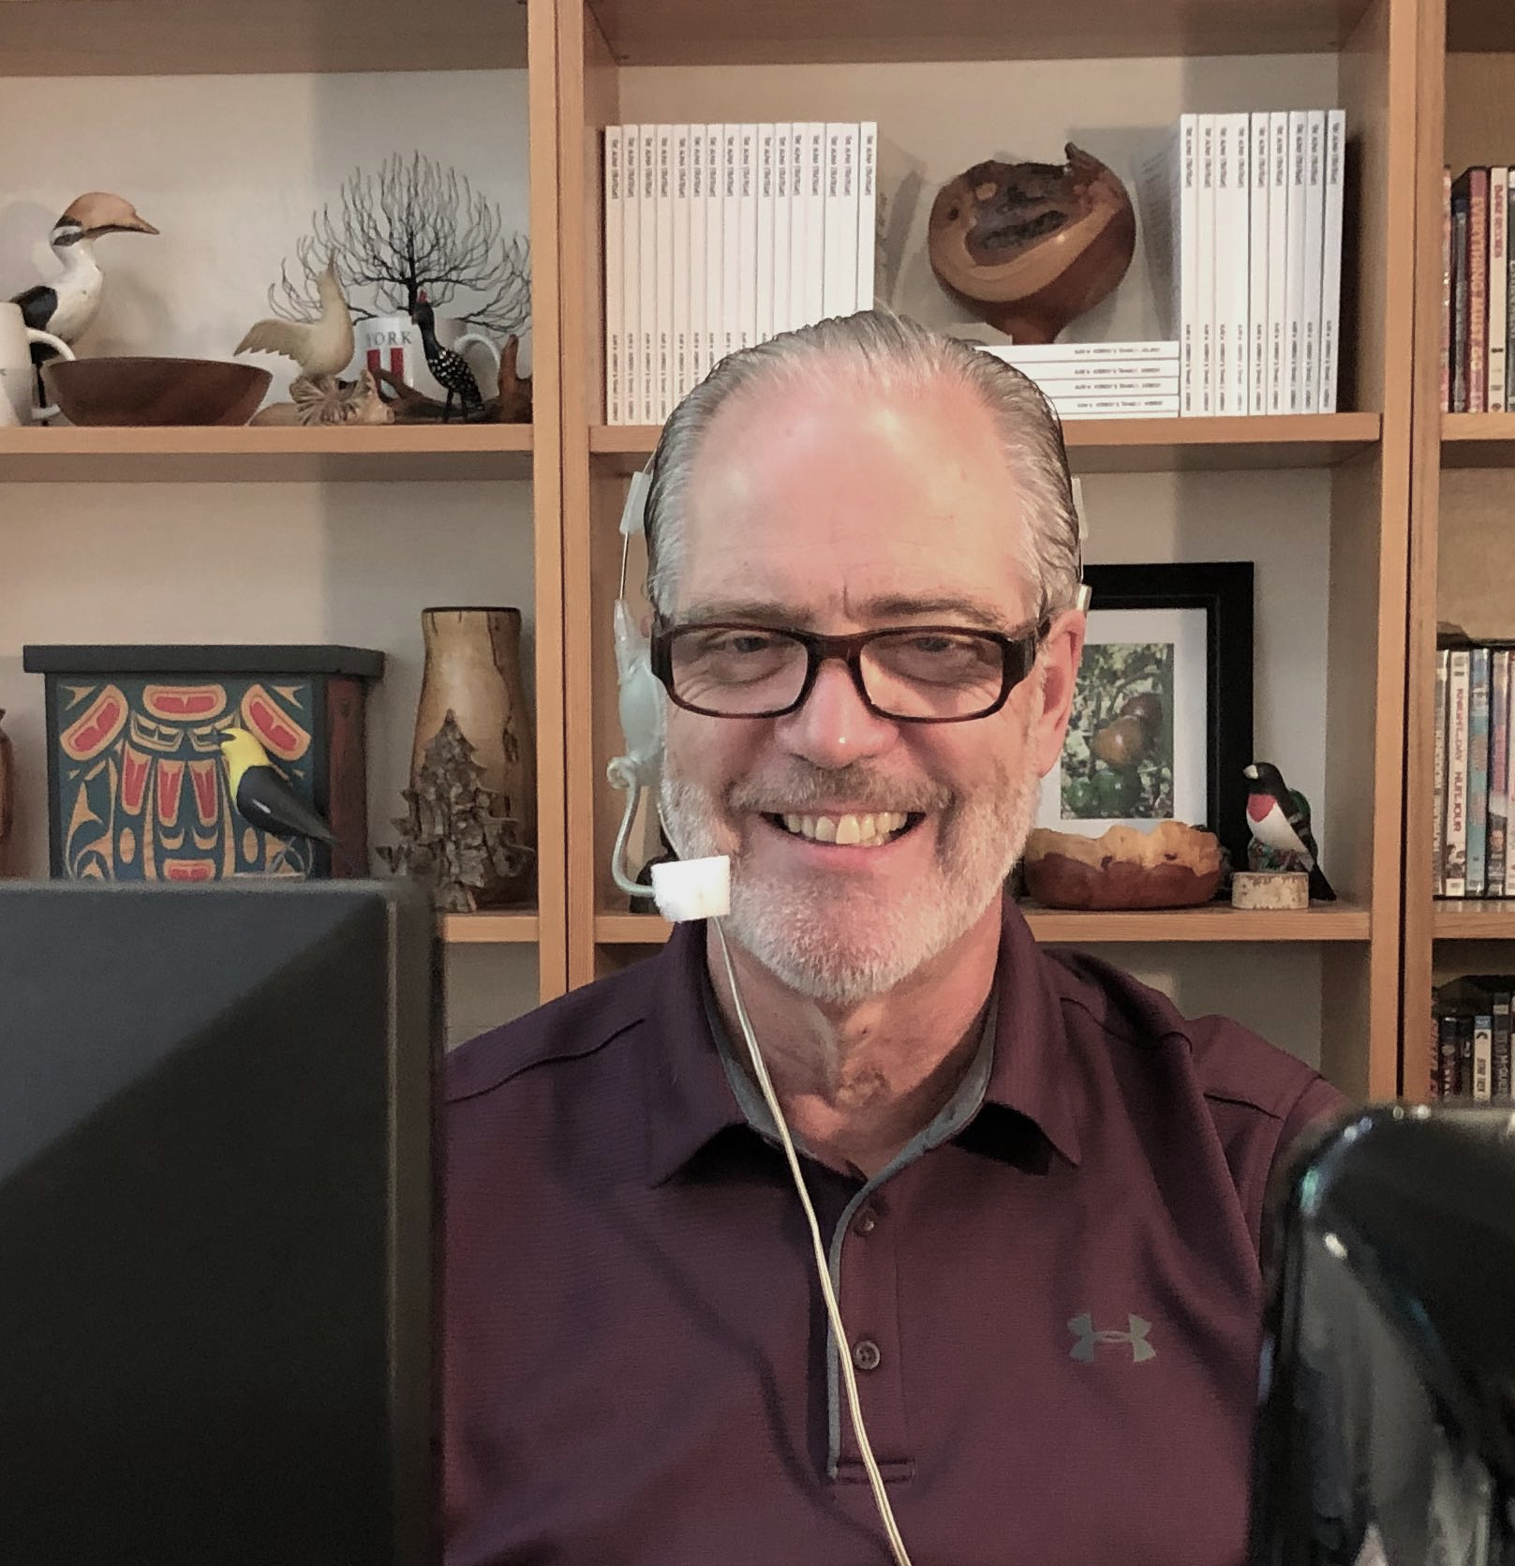
About the Presenter
Alan Kennedy BA LLB FCMC
Alan is the founding partner of Gibson Kennedy & Company, a Toronto consulting firm offering Canadian clients strategy counsel and competitive research services since 1990. Alan’s practice focuses exclusively on matters of strategy and its communication.
Alan has been teaching Strategic Management for the Schulich Executive Education Centre since 1992. Alan is also a member of the faculty for Management I, a one week course for new managers.
Alan’s book, The Alpha Strategies – Understanding Strategy, Risk, and Values in Any Organization is listed as a Kirkus Best Books of 2013. The Alpha Strategies is available at all online retailers.
Alan is an Honor Roll member and a Fellow of the Canadian Association of Management Consultants. Alan received his degrees from Dalhousie University and served as Senior Vice President & General Counsel for both Oxford Development Group and Campeau Corporation and as a member of the Board of Directors for both companies.

Slide 5
Course Schedule
Day One: Situation Analysis
9 – 10 Introductions and Defining Strategy
10:10 - 11 The Strategy System
11:10 - 12 Using the Strategy Model
12 -1:00 Lunch
1 - 1:50 Getting Ready for Planning
2 - 2:50 The Internal Assessment
3 - 3:45 The External Assessment
3:45 -4 The Situational Analysis
Day Two: Strategic Planning
9 – 10 Tarion Situation Analysis Review
10:10 - 11 Identifying External Factors
11:10 - 12 Connecting External Factors to Strategy
12 - 1:00 Lunch
1 - 1:50 Developing Strategic Issues
2 - 2:50 Testing Strategy
3 - 3:45 Communicating the Strategic Plan
3:45 -4 The Strategic Plan
Day Three: Business Planning
9 - 10 Strategy Choices Review
10:10 - 11 Reviewing the PSSA Strategic Plan
11:10 - 12 Identifying Strategic Plan Expectations
12 - 1:00 Lunch
1 - 1:50 Identifying Expectations Impact on Strategy Choices
2 - 2:50 Developing the Dept Business Plan
3 - 3:45 Business Plan Presentation
3:45 - 4 The Business Plan

Slide 6
Day One Schedule
9 – 10 Introductions and Defining Strategy
10:10 – 11 The Strategy System
11:10 - 12 Using the Strategy Model
12 -1:00 Lunch
1 - 1:50 Getting Ready for Planning
2 - 2:50 The Internal Assessment
3 - 3:45 The External Assessment
3:45 - 4 The Situational Analysis

Slide 7
Top of Mind
-
-
-
-
Notes:
Strategic Management © 2017 Alan W. Kennedy
1 - 7

Slide 8
Course Objectives
How to prepare and to evaluate a situation analysis
How to prepare and to evaluate a strategic plan
How to prepare and to evaluate a business plan

Slide 9
Course Deliverables
Day 1
Produce a Situation Analysis
Day 2
Produce a Strategic Plan
Day 3
Produce a Business Plan

Slide 10
Definitions
Situation
Analysis
The knowledge base to support strategy decisions
Strategic
Plan
A review of the 8 strategies common to all organizations
Business
Plan
An alignment of functional activities with expectations created by the strategic plan

Slide 11
Module 1
Defining Strategy

Slide 12

Strategy Definition
Strategy is a choice of action
“Our long term strategy is to be around for a long time.
Our short term strategy is not to do anything
that could screw up our long term strategy”
F. Thomas Stanfield, Chairman, President, & Founder’s Grandson
F. Thomas (Tom) Stanfield, who served as Stanfield’s Limited President, Chairman and CEO for 51 years, stepped down in January 2019
Notes:
WITF Media Strategic Leadership Program
Strategic Leadership and Critical Thinking

Slide 13
Two Factors Drive Strategy:
Imposed Expectations
External Reality

Slide 14
Module 2
The Strategy System

Slide 15
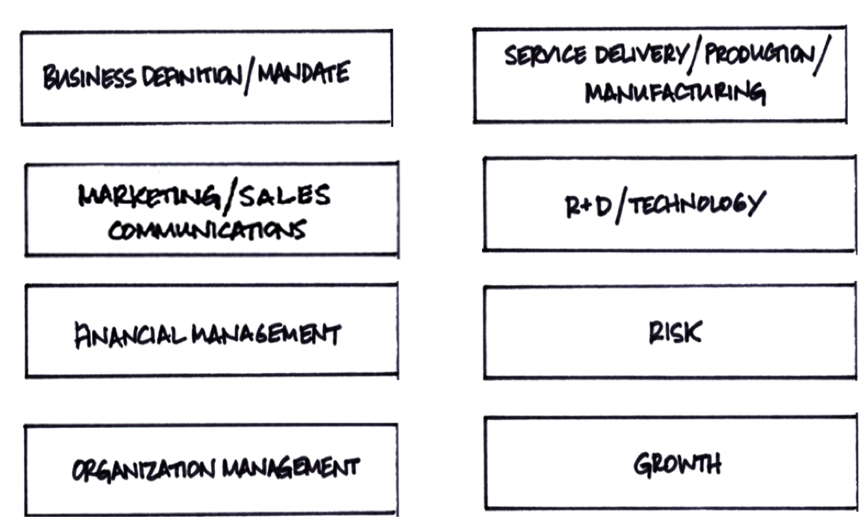
8 Strategies
Common to all Organizations
Notes:
Strategic Management © 2017 Alan W. Kennedy
1 - 15

Slide 16
Scope of the 8 Strategies
The 8 Strategy Model
Strategy | General Scope
Business Definition – Mandate – | Focus on positioning the business – How an outsider sees the business interpreting mandate parameters in the enabling Act or charter
Risk | Focus on the unacceptable and ways to manage it
Growth | Focus on type and rate of growth
Financial Management | Focus on sourcing, allocation, and management of financial resources
R&D / Technology | Focus on the creation and/or use of intellectual capital / technology
Organization Mgmt | Focus on sourcing, allocation, and management of human resources
Marketing & Sales – Communications – | Focus on identifying and capturing customers/clients – through to sales Focus on identifying and capturing trust & support of stakeholders
Service Delivery – a.k.a. Production – a.k.a. Manufacturing – | Focus on fulfilling the marketing/communications promise of value / relevance
Notes:
Strategic Management © 2017 Alan W. Kennedy
1 - 16

Slide 17
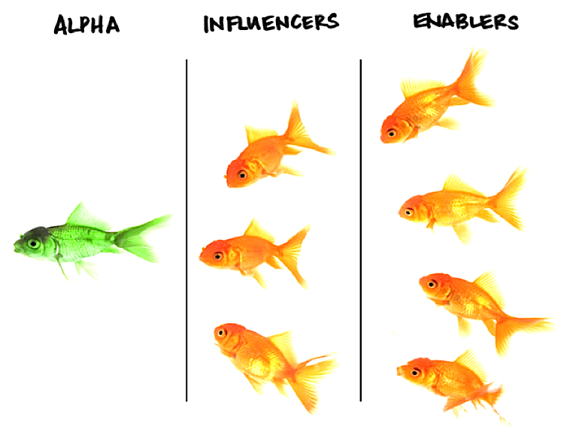
3 Types of Strategy are Common to all Organizations
Notes:
Strategic Management © 2017 Alan W. Kennedy
1 - 17

Slide 18
Strategy as a Dynamic System
Notes:
Strategic Management © 2017 Alan W. Kennedy
1 - 18

Slide 19
Definitions of Major Terms
Strategy: A description of chosen action
Situation Analysis: The knowledge base to support strategy decisions
Strategic Planning: A review of the 8 strategies common to all organizations
Business Planning: Any strategy planning to implement the strategic plan intent
Strategic Issue: A question whether to replace or to improve existing strategy
Strategic Management: The leveraging of strategic thinking of individuals
Strategic Thinking: Thinking about how imposed expectations and the realities of the external environment should impact management of assigned responsibilities
Expectations: Guidance on a hoped-for outcome
Metrics: Anything expressed as a number
Vision: A description of the successful outcome from long term pursuit of dominant strategy
Mission: The Business Definition / Mandate strategy

Slide 20
Module 3
Using the Strategy Model

Slide 21
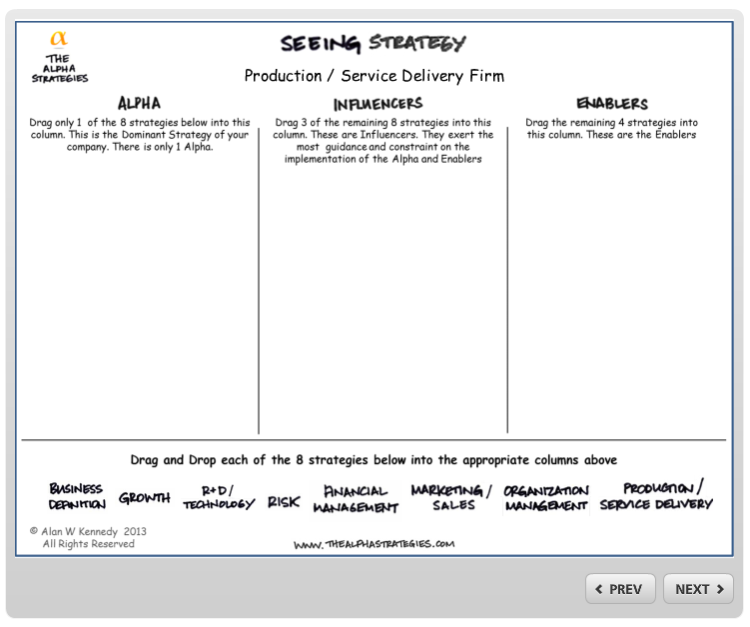
Configuring the Strategy System
Notes:
Strategic Management © 2017 Alan W. Kennedy
1 - 21

Slide 22
Module 4
Getting Ready for Planning
“It is not the unknown that gives us trouble. It’s what we know that ain’t so.“
Will Rogers from Mark Twain from Josh Billings

Slide 23
Day One Output:
Situation Analysis Report
The Scope of
Acceptable
Change
Stakeholder Appetite for Change
Internal
Assessment
Current Strategy Analysis
Customers & Markets
Industry
Competitors
Trends
Best Practices
External
Assessment
Conclusions
A listing of factors most likely to impact the Firm
Preliminary insights on questions of strategy

Slide 24
Tarion SWOT
Tarion Strengths & Weaknesses – Controllable Factors





Tarion Opportunities / Threats – Uncontrollable Factors

Slide 25
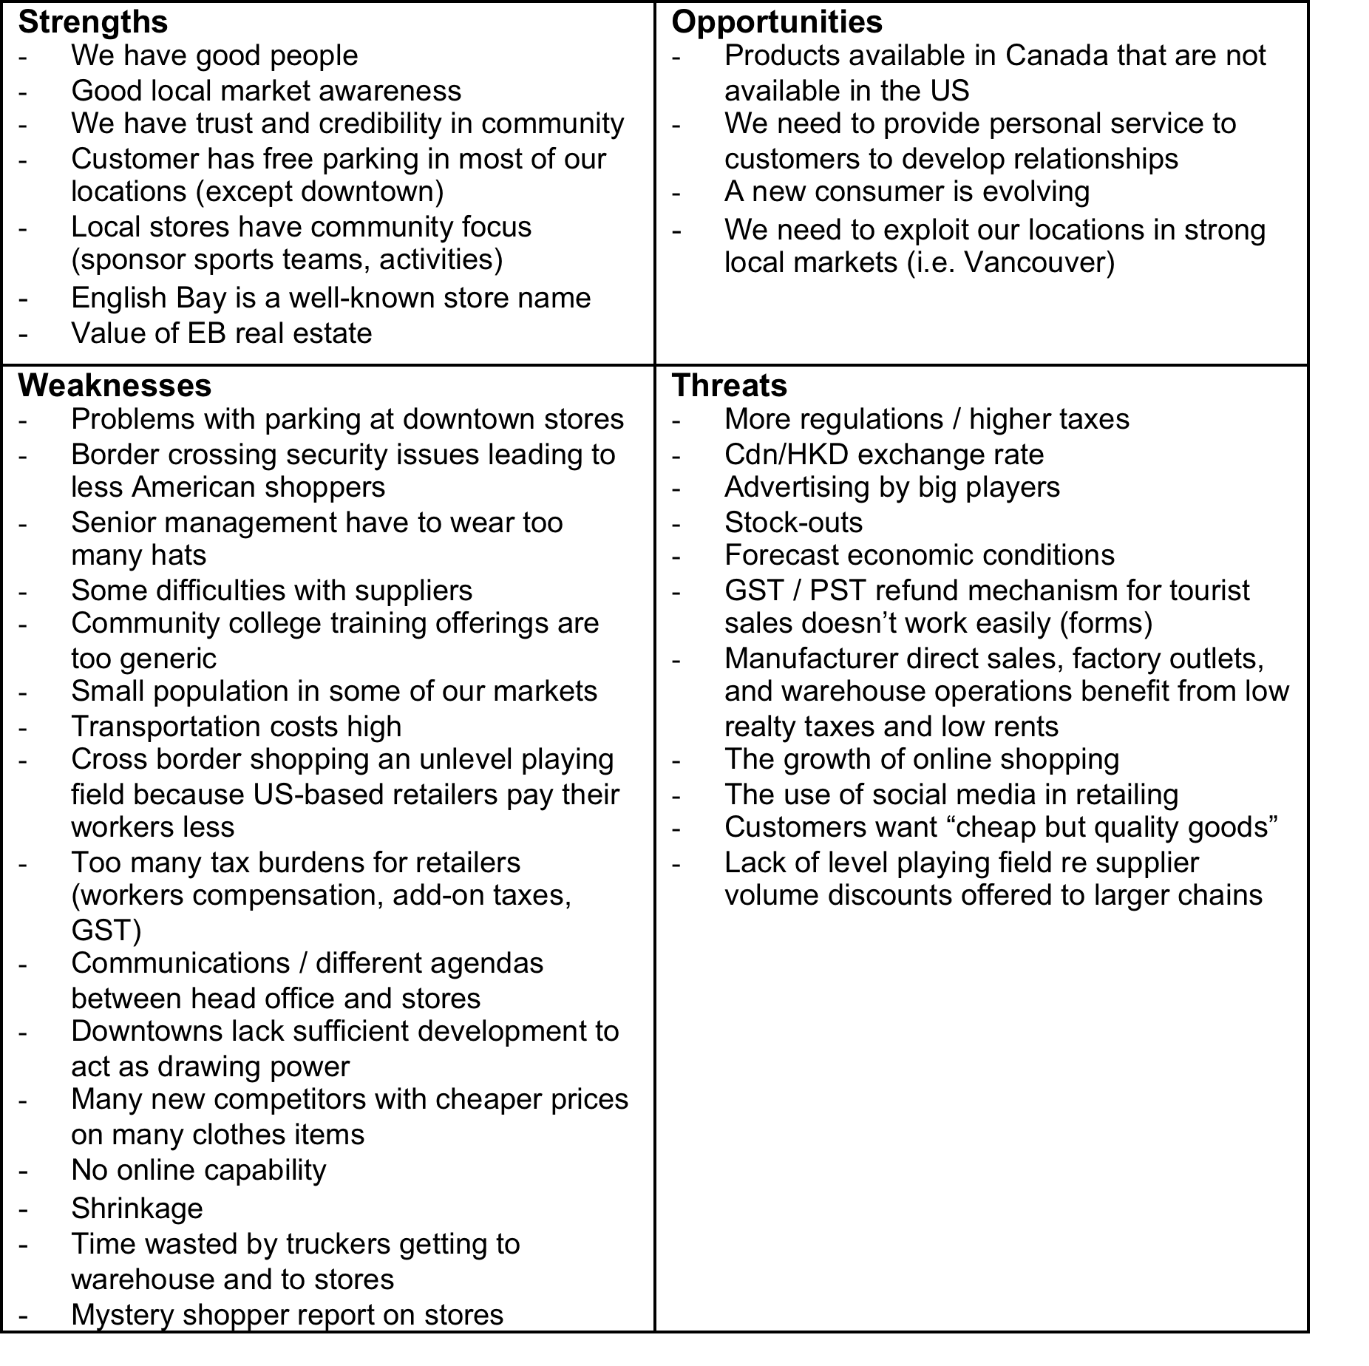
Typical SWOT as Lists

Slide 26
SWOT:
The Basis of All Strategic Thinking
Strength
Strategy: Defend
Strategy: Attack
Threat
Opportunity
Strategy: Retreat
Strategy: Retrain
Weakness
Heinz Weihrich, The TOWS Matrix, A Tool for Situational Analysis.
Source: http://www.usfca.edu/fac_staff/weihrichh/docs/tows.pdf

Slide 27
Focus Strengths & Weaknesses Analysis on the 8 Strategies
The Alpha Strategies | Strengths | Weaknesses
Business Definition / Mandate
Risk
Growth
Financial Management
R&D /Technology
Organization Mgmt
Marketing/Sales /Comm
Service Delivery / Production / Manufacturing

Slide 28
Focus Opportunities & Threats Analysis on External Factors
External Factors | Opportunities | Threats
Customers / Markets
Industry
Competitors
Best Practices
Trends

Slide 29
Stakeholder Identification
Who are the major Tarion stakeholders?
Stakeholder Categories | Actual Stakeholders
 | ⬥  
 | ⬥  
 | ⬥  
 | ⬥  
The Authority Group
Those Stakeholders who approve the plan and authorize implementation
The Involve Group
Stakeholders who should be involved because of the role they will play in implementation
The Inform Group
Stakeholders who need to be told what to do so that their actions are consistent with implementation
The Consider Group
Any Stakeholders not falling in any of the above categories and who could have a response to implementation

Slide 30
Stakeholder Identification
Stakeholder Categories | Actual Stakeholders
The Authority Group Those Stakeholders who approve the plan and authorize implementation | The Board
The Involve Group Stakeholders who should be involved because of the role they will play in implementation | Tarion Management and Staff
The Inform Group Stakeholders who need to be told what to do so that their actions are consistent with implementation | Tarion Employees
The Consider Group Any Stakeholders not falling in any of the above categories and who could have a response to implementation | Consumer Associations - Builder Associations – Ministry Industry Professionals - Lawyers - Architects - Engineers - Bankers Industry vendors: trades, manufacturers DAA Critics - Other DAA’s Other Ministries: (MMAH) - Other gov’t orgs: (CMHC) Competitors: (warranty companies) Other jurisdictions: (B.C.) Media (Print / Radio / T.V. / Magazine) Municipalities

Slide 31
Stakeholder Expectations
Stakeholder Categories | Actual Stakeholders | Expectations
The Authority Group | ⬥  
The Involve Group | ⬥  
The Inform Group | ⬥  
The Consider Group | ⬥  

Slide 32
Scoping the Appetite for Change
Circle the symbol that would be former CEO Chris Norcross’s likely answer
X means change is acceptable ● means change is not acceptable
Question: What does it mean if not all 8 strategies can be candidates for change?
Risk
Business Definition /
Mandate
X
Growth
X
X
●
●
●
Financial
Management
X
●
●
X
Organization
Management
●
●
●
X
X
Service Delivery /
Production /
Manufacturing
Marketing / Sales
Communications
X
R&D /
Technology

Slide 33
Scoping the Appetite for Change
X = Change Acceptable
● = Change Not Acceptable
Consumer Groups:
New Homebuyers:
New Homebuilders:
Board Mgmt:
Mandate
Risk
Growth
X
X
X
●
●
●
X
●
●
X
Organization
Management
Financial
Management
●
●
●
X
X
Warranty Claims
Management
Communications
X
R&D
/ Technology

Slide 34
Module 5
Internal Assessment

Slide 35
Configuring the Tarion Strategy System
Notes:
Strategic Management © 2017 Alan W. Kennedy
1 - 35

Slide 36








From Strategy to Org Design
Board of Directors
President
& CEO
VP &
CFO
VP &
CIO
VP &
General Counsel
VP Underwriting
VP Warranty Services
VP & Chief Admin Officer

Slide 37
Strengths & Weaknesses
Business Model Management | Strengths | Weaknesses
Licensing & Underwriting & Enforcements | $2.4 B in condo builder security conditions of licensing mandatory registration stable builder population | Bureaucratic processes Have not kept updating processes
Warranty Services | Warranty policy document Builder performance timelines document | complaints process slow and bureaucratic
Financial Management | strong capitalization $2.4B in builder security | not enough disclosure
General Counsel
I.T. | Call centre | could be much more use of technology
Human Resources |  | productivity compensation
Stakeholder Engagement |  | Government clearly not pleased
Stakeholder Communications |  | Stakeholders not pleased

Slide 38
Strengths & Weaknesses
Business Model Management | External Factors Impacting Performance
Licensing & Underwriting & Enforcements | Industry best practices, complaint, online practices best practices - insurance industry practices – online
Warranty Services | New home builder performance - warranty industry practices best practices - e-commerce - builder expectations consumer expectations – Ministry Media Transparency
Risk | Present building code - The Act & regulations -case law / judicial decision - construction technology
Finance | insurance industry practices -Stock/Bond market performance financial regulatory requirements - builder expectations B.C. Home Warranty - Warranty Industry Practices -Practices of other DAA’s
I.T. | technology
Human Resources | Builder expectations on productivity

Slide 39
Module 6
External Assessment

Slide 40
The Major Categories of External Factors
Stakeholder
Expectations
Customers & Markets
Industry Dynamics
Competitors
Trends
Best Practices

Slide 41
Customer Analysis
4.2 Customer
Identification
1. Who are our most important customers?
2. What criteria drive the customer purchase decision?
3. How do we compare, in the customer’s view, to the competition?
4. Which of our products and services are truly valuable to them?
5. What are the steps and who influences the purchase decision?
6. How are customer criteria and behavior likely to change?
7. What products and services are our customers going to need?

Slide 42
Customer Segmentation Analysis
Restated for Public Sector Service Organizations
4.2 Customer
Identification
1. Does our mandate suggest who should be our primary focus for its effective delivery?
2. What causes these persons to use our services ?
3. How do we compare to alternatives for addressing the need assumed in our mandate?
4. Which of our programs / services are truly successful in addressing the need ?
5. Do we understand the factors driving the creation of the need ?
6. How is need of our primary focus group likely to change?
7. What services are users going to need ?
See also: Banishing Bureaucracy 1998, David Osborne

Slide 43
Tarion as Warranty Insurer
Customer Analysis
Question | Answer
Does our mandate suggest who should be our primary focus for its effective delivery? | Builders are the most important customer. “Get the builder to do it right. That keeps the homebuyer happy. That makes the warranty program look good. That makes politicians happy.” Builders pay for the warranty Consumers don’t care about new home warranty until they have a claim. Consumers cannot be educated on the value of new home warranty
What attracts these persons to use our services? | When the new homebuyer finds they have a problem, they read the warranty and then contact Tarion
3. How do we compare to alternatives for addressing the need assumed in our mandate? | Every study done on warranty finds the Tarion model is superior. However, the home buyers subjected to the “failure to perform” claims stream are generally not pleased with the experience.
4. Which of our programs / services are truly successful in addressing the need ? | Regulatory control of entry to and supervision of the industry The bankrupt builder claims stream is well received. New condo owners are generally happy because Bldr security works
5. Do we understand the factors driving the creation of the need ? | Lack of understanding of the implications associated with changing building practices and technologies will continue to drive the need Failure of the building code to keep up with changing technologies
6. How are the needs of our primary focus group likely to change? | Continued growth of large condominium construction, renovations, and conversions raises new issues
7. What services are users going to need ? | Conversion coverage; maybe large-scale renovation coverage Possible building code expertise (UK model)

Slide 44
Tarion as Regulator
Primary Stakeholder Focus Analysis
Question | Answer
1. Does our mandate suggest who should be our primary focus for its effective delivery? | Builders are the primary focus of the regulator. The mandate requires the regulator to enforce the Act’s provisions which amongst other things, requires, mandatory builder registration, new home registration, and enforcement of Act compliance, being primarily illegal (i.e. unregistered new home building for sale).
2. What attracts is the cause of their unwillingness to comply? | Unwillingness of some builders to comply is caused by their belief that they won’t get caught because they are building in small numbers, have co-opted the purchaser,
3. How do we compare to alternatives for addressing risk assumed in our mandate? | The KPMG global study suggests the paired role of regulator/warranty insurer is a key success factor, industry best practice, and probably explains Tarion’s success. That said, there are many who would prefer to see the regulator returned to gov’t.
4. Which of our programs / services are truly successful in addressing the reducing risk? | Working in cooperation with municipal building permit departments has enabled effective identification of non-complying builders and increased conviction rates
5. Do we understand the factors driving the creation of the risk | Repeat offenders are likely to continue to offend Failure to review building permits against home registrations Offender belief that it is hard to get caught
6. How is the risk behavior of our primary focus group likely to change? | As enforcement improves with more cooperation with municipalities and the use of analytical software to profile likely offenders, very likely these illegal builders will look for opportunities outside the scope of the Act such as renovations, retrofits, and conversions
7. What services are going to be needed to address new emerging risks? | The renovations, retrofits, and conversions market for homes will need regulating

Slide 45
Markets – Clusters of Customers
Growth
1 – shrinking market and/or market share
4 – only able to maintain existing business
7 – significant growth in market and/or
market share
Profitable
1 – not profitable
4 – break-even
7 – very profitable
Competition
1 – significant competition
4 – competition is manageable
7 – no competition

Slide 46
Demand Analysis Methodology
Market Analysis Restated for Public Sector
Purpose | To identify specific opportunities for priorities over the planning period
Grid Design | Horizontal Axis – specific products or services Vertical Axis – specific clusters for those services
Scores | For each cell, assign a score from 1 to 7 for each of the following variables.
Growth of Need / Risk | Assess the potential for growth of the need / risk programs / services 1 – shrinking overall need / risk 4 – no change from today 7 – significant growth in need / risk
Sustainability | Assess the likely financial sustainability of delivering services to meet the need / risk 1 – sustainability is a great risk 4 – no change from today 7 – sustainability not a risk
Alternatives | Assess the attractiveness of emerging alternatives to address the need / risk 1 – significant attractive alternatives are becoming apparent 4 – no change in alternatives apparent 7 – no attractive alternatives emerging or apparent
Cell Scoring | Each cell score is the total of the variables scoring for that cell Highest score: 21, representing a need / risk on which we should focus Lowest score: 3, representing limited perceived value to addressing need / risk

Slide 47
Demand Analysis in the Public Sector
G=Growth S=Sustainability A = Alternatives
Services | Need / Risk Segments
 |  | G= | G= | G= | G= | G=
 |  | S= | S= | S= | S= | S=
 |  | A= | A= | A= | A= | A=
 | Total
 |  | G= | G= | G= | G= | G=
 |  | S= | S= | S= | S= | S=
 |  | A= | A= | A= | A= | A=
 | Total
 |  | G= | G= | G= | G= | G=
 |  | S= | S= | S= | S= | S=
 |  | A= | A= | A= | A= | A=
 | Total

Slide 48
Industry Dynamics
Segment What is my chosen market called?
Segment Size / Growth How big is it and is it growing?
Segment Dynamics What dynamics are most shaping the segment? (e.g. competitive rivalry, customers, suppliers, entry barriers, alternatives)
Critical Success Factors What must a competitor do to succeed given the dominant industry dynamics?
Segment Evolution How is this segment likely to change over time?

Slide 49
Warranty Industry Analysis
Segment What is my chosen market called? | New Home Warranty
Segment Size / Growth How big is it and is it growing? | Averages 50,000 new homes but drops dramatically in times of recession Growth is a function of condo popularity in the major cities, provincial economy and population growth
Segment Dynamics What dynamics are most shaping the segment? Customers/competitors/ Suppliers/Barriers to Entry/Alternatives | Consumers don’t want to pay cost until they need protection Mortgage lenders require warranty on mortgages Competitive pressure: lower costs, more choice
Critical Success Factors What must a competitor do to succeed? | not-for-profit status of Tarion (to recognize economic fragility) industry self-management model (to recognize need to balance true cost/liability associated with added consumer protection elements bundled regulatory authority / insurance responsibility (to recognize need to enforce a minimum standard) no-fault coverage for consumers (i.e. whether home or builder are registered) autonomy from government to isolate capital reserves and fees from political pressure ongoing management of stakeholder expectations to stay aligned with major stakeholder groups
Segment Evolution How is this segment likely to change over time? | The model could evolve as the regulator of more segments of the housing industry

Slide 50
Competitor Analysis
Industry
Positioning
Who do I compete with in my market segments?
What segments are my competitors focusing on?
- What segments should I focus on?
Critical
Success
Factors
- What must I truly understand about my competitors?
(e.g. strategies, strengths, weaknesses and areas of
relative performance)
Industry
Evolution
- Who are my future competitors?
What functional areas are likely to become the most
important in the future?

Slide 51
Warranty Competitor Analysis
Warranty Industry Attractiveness | Competitors | Travelers The Guarantee National Home Warranty & Aviva Canada Pacific Protected
 | Competitor Focus | Excess deposit insurance for condo buyers (i.e. over $20,000 Conversion project warranty insurance
Warranty Industry Critical Success Factors | Competitor Strengths | Cost Control / Productivity Online accessibility – Clear processes Marketing - Pricing Product selection Financial strength Developing a strong builder customer base
 | Competitor Weaknesses | No commitment to stay in the market No commitment to small builders Warranty is a trigger product
Warranty Industry Evolution | Likely Future Competitors | Private sector competitors from other provinces/US
 | Likely Areas of Functional Excellence | On-line delivery of builder and consumer services

Slide 52
Competitor / Alternatives Analysis
Restated for Public Sector
Service
Sustainability
Who is offering / can offer alternatives to our services?
What segments are they focusing on?
- What segments should we focus on?
Critical
Success
Factors
- What must we understand about alternatives / competitors?
(e.g. strategies, strengths, weaknesses and areas of
relative performance)
Service
Evolution
- Who / What are the future competitors / alternatives?
What functional strengths are likely to become the most
important in the future?

Slide 53
Trend Analysis in 3 Steps
1. Source of Trends | - Social media
2. What is the Emerging Trend? | - Using social media as a political activist tool
3. What’s the impact on us? | - What is getting said on FB, Twitter, etc is getting into mainstream media and influencing political and business decisions

Slide 54
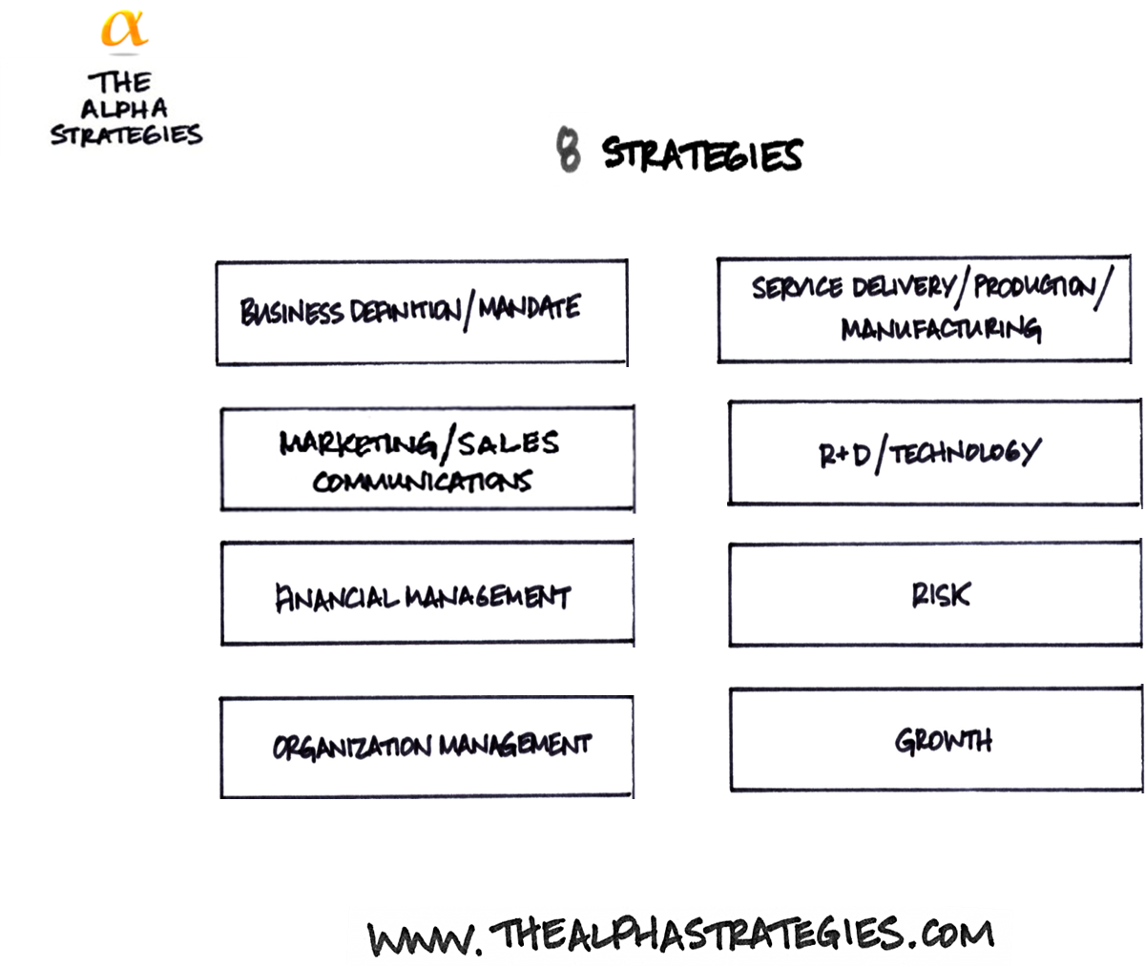
The Key to Strategic Planning:
Which one strategy is likely to be the most significantly impacted?
Customers & Markets
Competitors
Industry Dynamics
Trends
Best Practices

Slide 55
Schedule “A”
The Situation Analysis

Slide 56
Day One Deliverable: The Situation Analysis
Day 1
Produce a Situation Analysis
Day 2
Produce a Strategic Plan
Day 3
Produce a Business Plan

Slide 57
Day One Wrap Up
Module 1 Strategy is a choice of action
Module 2 8 strategies & 3 types of strategy in every organization
Module 3 The 8/3 model enables a focused discussion of strategy
Module 4 Expectations for change drive strategic planning
Module 5 Internal situation analysis can identify external factors
Module 6 External factors are the driver of all strategy decisions

Slide 58
Day Two – Preparation
- Review the Day 2 Binder Materials
Identify the top 3 external factors you believe Tarion must address because those factors will impact Tarion the most significantly over the next 3 to 5 years

